Slide 1
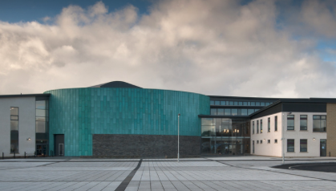
Kirkwall Grammar School 2021

Slide 2
Fact File
Head Teacher: Mr Don Hawkins
S1-S6 - age 11/12 to age 17/18 years old
Catchment area: the town of Kirkwall, the East Mainland of Orkney and the North and South isles, 13 linked Primary Schools and
4 Junior High Schools
Number of teachers: approx. 80
(including part-time and job-share)

Slide 3
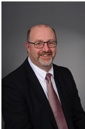
Mr Hawkins Head Teacher

Slide 4
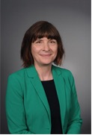
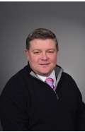
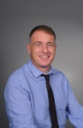
Senior Leadership Team
Ms Devlin
Deputy Head Teacher
Year Head for S1/S2
Mr Harvey
Deputy Head Teacher
Year Head for S3/S4
Mr Ewing
Deputy Head Teacher
Year Head for S5/S6

Slide 5
Guidance Department
Copinsay
Mrs Woods
Eynhallow
Ms Taylor
Fara
Mr Berry

Slide 6
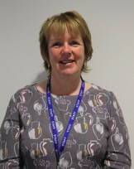
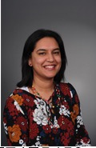
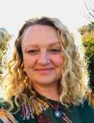
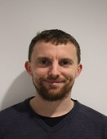
Guidance Team
Mrs Marlyn Firth - Guidance Manager
Mrs Raksha Woods
Guidance Teacher for
Copinsay
Ms Bridget Taylor
Guidance Teacher for
Eynhallow
Mr Mark Berry
Guidance Teacher for
Fara

Slide 7
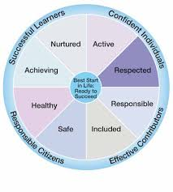
 | All teachers have a responsibility for the health and well being of all students
 |  |  | Depute Head for Pupil Support: Ms Devlin
 |  |  | Guidance Manager: Mrs Firth
 |  |  | Principal Teacher Curriculum Support: Ms Phillips
 | Depute Heads |  | Ms Devlin |  |  |  | Mr Harvey |  |  |  |  | Mr Ewing
 | Guidance Teacher ê |  | S1 |  | S2 |  | S3 |  |  | S4 |  | S5 |  | S6
 | Copinsay
 | Mrs Woods
 | Eynhallow
 | Ms Taylor
 | Fara
 | Mr Berry

Slide 8
Welcome bell | Monday - Thursday 8.30am | Friday 8.30am
Registration/Tutor Group time | 8.35am | 8.35am
Period 1 | 8.45am | 8.45am
Period 2 | 9.35am | 9.35am
Interval | 10.25am | 10.25am
Period 3 | 10.40am | 10.40am
Period 4 | 11.30am | 11.30am
Period 5 | 12.20pm | 12.20pm end of school day
Lunch | 1.10pm
Period 6 | 1.55pm
Period 7 | 2.45pm
End of school day | 3.35pm
The School Day
The normal school day starts at 8.35am each morning and finishes at 3.35pm each afternoon, except Friday when classes end at 12.20pm - with lunch available in KGS from 12.20pm-12.45pm.
Lesson and interval times may vary during the Covid-19 Period
A bell rings at all period change times and before registration.

Slide 9
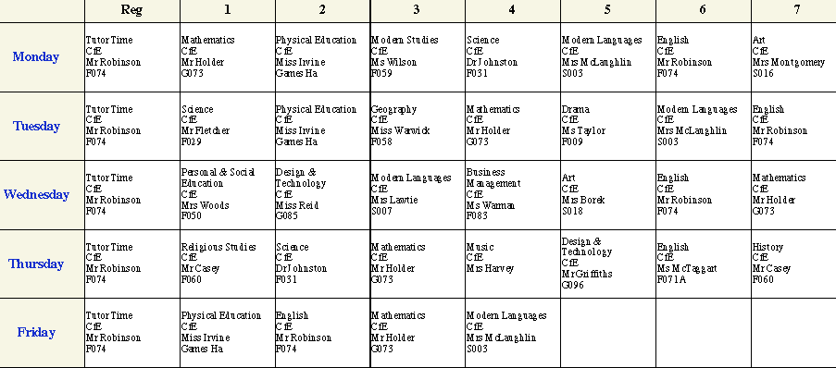
Here is what a typical 1st Year KGS timetable looks like:
Timetable

Slide 10
Attendance
Illness: Your parent/carer should phone the school (87 2102) before 9.00am each morning you are absent. A text message is sent out if a pupil is absent and there has been no phone call.
Signing In Late: If pupils arrive late, they must sign in at the office/reception and explain the reason for being late. Providing a note from a parent/carer or an appointment card if you had a medical /dental appointment is helpful.
Signing Out: Pupils need to sign out at the office if they have to attend a doctor’s or dentist’s appointment during the school day. They must bring an appointment card/note from a parent/carer. On return to school they must sign back in at the office/reception.
Sick Bay: If pupils feel ill during the school day they should ask permission from their teacher to go to Sick Bay. If it is necessary to send a pupil home, parents/carers will be contacted. Pupils must not just go home or contact their parent/carer themselves using their mobile phone. The Office Staff will support appropriate contact with home.
Absences – not illness: Parents should inform the school office and your Guidance teacher if pupils are going to be absent during term time. If pupils are going on a trip/activity, parents/carers should write to the Head Teacher asking for permission; the absence will be recorded appropriately. If in doubt, parents/carers should speak to the Guidance Teacher.

Slide 11
Dress Code
We hope that pupils will be proud to identify with KGS and wear the following dress code every day:
• A hoodie, fleece, polo shirt or t-shirt that displays the school logo should be worn at all times as the top layer of clothing.
School tops SHOULD NOT be worn under other clothing and should be seen at all times.
Pupils may wear a white, black or navy shirt and school tie.
Plain dark trousers/jeans or skirts.
No shorts, patterns, stripes or bright colours.
School tops and ties are available from: Logo Orkney and Trek and Travel.
Local charity shops and KGS may also have school dress code which has been donated.
Financial assistance may be available from Orkney Islands Council for school clothing.
PE: For indoor learning, pupils should wear a plain t-shirt or top, shorts and training shoes (with non-marking soles). Tracksuit trousers can be worn for outdoor activities along with a sweatshirt or similar top.

Slide 13
The KGS Successful Learner
At KGS we have expectations which contribute to pupils being as successful as they can be in their learning. We expect all pupils to arrive at school prepared for classes and ready to engage with learning.
Pupils should:
Arrive punctually in the morning and to all lessons.
Listen and follow instructions straight away.
Always bring the correct equipment.
Mobile phones should be off and in school bags at all times, unless your teacher has given permission to use your mobile phone in class as part of learning and teaching.
Be focused and engaged in all lessons and learning.
Make progress on agreed targets and next steps discussed with teachers.
Do their best to complete all set tasks.

Slide 14
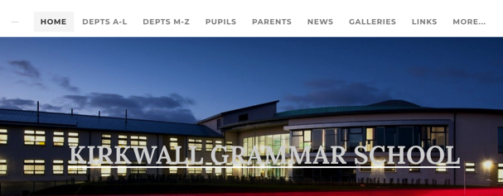
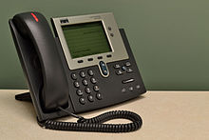
Sources of information:
The school website: www.kgsorkney.com
Facebook page: Kirkwall Grammar School
All the Houses have their own Facebook page – search: ‘KGS Copinsay’, ‘KGS Eynhallow’,
‘KGS Fara’
Pick up the phone and speak to your Guidance Teacher: 87 2102
Email your Guidance Teacher – see the school website for their email address

