Slide 1
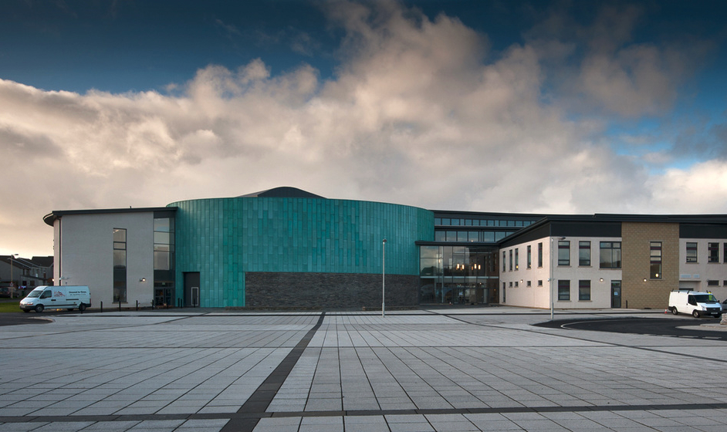
Welcome to Kirkwall Grammar School
Information for Parents/Carers of Primary 7 Pupils, 2020

Slide 2
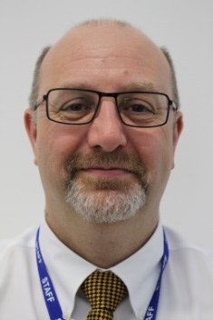
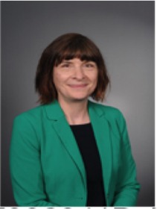
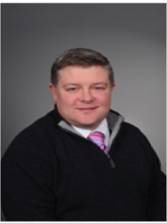
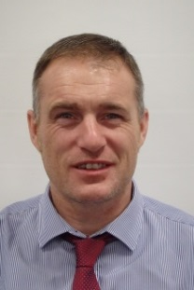
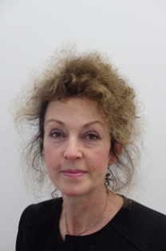
Senior Leadership Team
Mr Don Hawkins Head Teacher
Ms Jenny Devlin Depute Head Teacher
Head of S1 & S2
Mr Alasdair Harvey Depute Head Teacher
Head of S3 & S4
Mr Neil Ewing Depute Head Teacher
Head of S5 & S6
Mrs Karen Kent Business Manager

Slide 3
Guidance Department
All pupils are allocated to a House. They can earn points for their House in various ways throughout the session. There are inter-house competitions such as sporting activities and Maths quizzes. House points can also be awarded by teachers for good work and for an improvement in work. The House that collects the most points in the session is awarded the House Cup at the end of the year.
Copinsay
Eynhallow
Fara

Slide 4
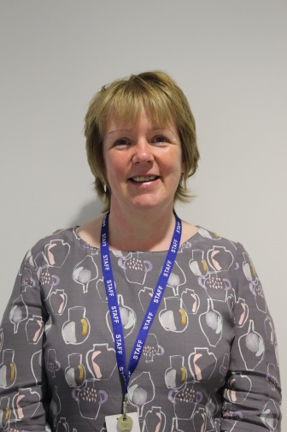
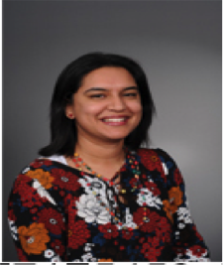
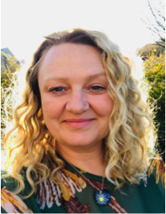
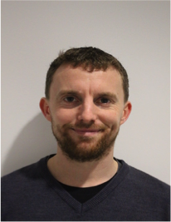
Guidance Team
Mrs Raksha Woods
PT Guidance
Copinsay
Ms Bridget Taylor
PT Guidance
Eynhallow
Mrs Marlyn Firth
Guidance Manager
Mr Mark Berry
PT Guidance
Fara

Slide 5
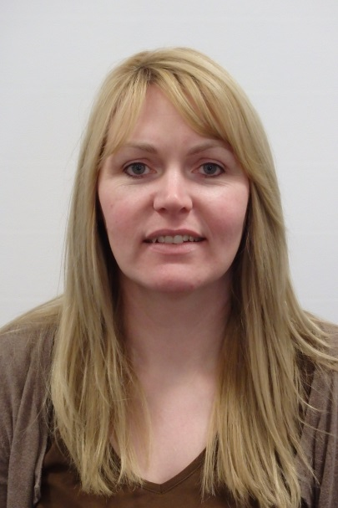
Curriculum Support at KGS
Principal Teacher of Curriculum Support
Ms Marie Phillips

Slide 6
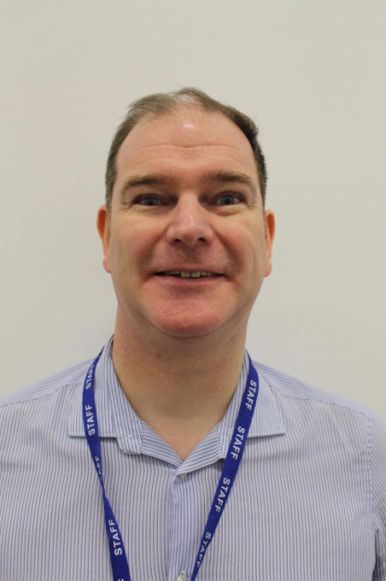
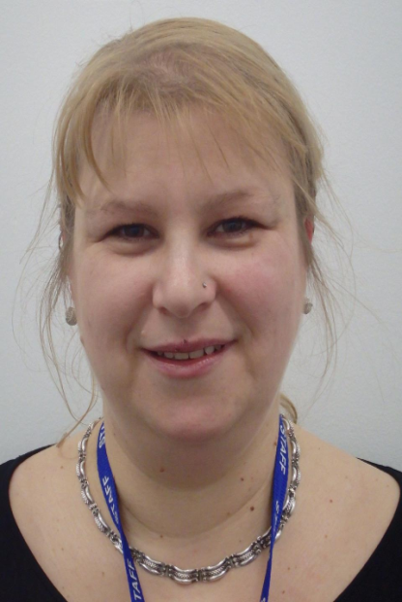
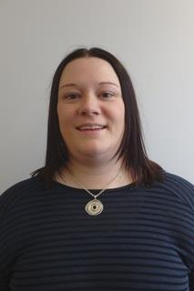
Curriculum Support teacher link to each House
Copinsay
Eynhallow
Fara
Mr Omand
Mrs Sandor
Miss Gray

Slide 7
At KGS the Guidance teacher is the key link person for parents/carers. Their role is to:
Get to know each pupil individually: their learning styles, strengths, interests, skills and talents
Link with subject teachers and parents/carers making sure that pupils are achieving their best
Hear any concerns and help resolve any challenges

Slide 8
What is the role of Guidance and support staff during the Transition process?
The PT Curriculum Support and the Guidance Manager liaise with primary schools throughout the year, gathering information to support pupils in relation to transition
KGS staff start to attend any scheduled Review Meetings for pupils with Additional Support Needs
KGS Guidance and support staff meet with P7 teachers, Head Teachers and primary support staff to gather information to support transition needs
Guidance and support staff deliver a presentation about KGS to Primary 7 pupils
All of this has taken place this session, some of it remotely!

Slide 9
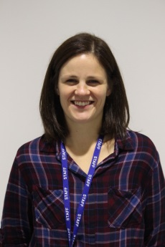
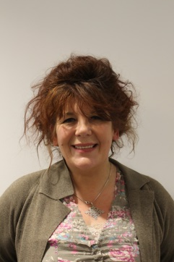
Further Support at KGS:
Amy Berry: Our Home School Link Worker………………
Mara Broadhurst: Our Youth Worker………………………
In School Counselling Service
Autism support, Hearing Support – this is provided in partnership with Pupil Support, OIC
Educational Psychology
School Health Team

Slide 10
As parents/carers we want you to be:
Informed- knowing what is going well with your child and whether there are any learning concerns
Feel welcome and part of our school community
Working in partnership with the school, in all aspects of your child’s learning experiences

Slide 11
Dress Code
KGS pupils wear one of the following tops with the school logo as their top layer at all times:
Hoodie
Polo-shirt
T-shirt
Zip top fleece/cardigan
A white, black or navy shirt and a school tie are suitable under the school top.
Pupils should also wear:
Plain dark trousers, jeans or skirts

Slide 12
Dress Code
School tops and ties are available from:
Logo Orkney, 40 Albert Street Kirkwall
Trek and Travel 15-17 Bridge Street, Kirkwall
A Fair Trade option can be ordered online (please ask for details).
Uniform without the religious motto is also available.
Donated uniforms are also available from the school ( please just ask) as well as in local charity shops.

Slide 13
Dress Code: Physical Education
Indoors
Pupils should wear a plain t-shirt or top, shorts and training shoes (with non-marking soles).
Outdoors
Tracksuit trousers, sweatshirt or similar top.
Swimming
Pupils should bring a towel and either trunks or a one piece swimming costume.

Slide 14
Warning bell | 8.30am | Friday 8.30
Registration/Tutor Group time | 8.35am | 8.35am
Period 1 | 8.45am | 8.45am
Period 2 | 9.35am | 9.35am
Interval | 10.25am | 102.5am
Period 3 | 10.40am | 10.40am
Period 4 | 11.30am | 11.30am
Period 5 | 12.20pm | 12.20pm end of school day
Lunch | 1.10pm
Period 6 | 1.55pm
Period 7 | 2.45pm
End of school day | 3.35pm
The KGS School Day :
Monday-Thursday
Start: 8.35am
End: 3.35pm
Friday: classes end at 12.20pm (with lunch available from 12.20pm-12.45pm)
S1 pupils are let out of class 5 minutes before lunch.
A bell rings at all period change times and before registration.

Slide 15
Food!
Breakfast: Breakfast foods are available from 8.10am – 8.30am in the Dining Hall. There are a range of options including cereal and fresh fruit and drinks
Break time: A range of snack are available during morning break – home baking, hot rolls, fruit and healthy snacks.
Lunch: Most pupils at KGS have school lunches but some go home, take a packed lunch or go into town. First years are strongly encouraged to have lunch in school for the first term.
If pupils are entitled to Free School Meals then they can either have the two-course main meal or items from the snack bar to the same value.
We are a health promoting school; chips are available once a week and we discourage fizzy drinks and encourage water bottles. No energy drinks should be brought into school.
Pupils can remain in the building at lunchtimes in the Dining Hall or the social areas.

Slide 16
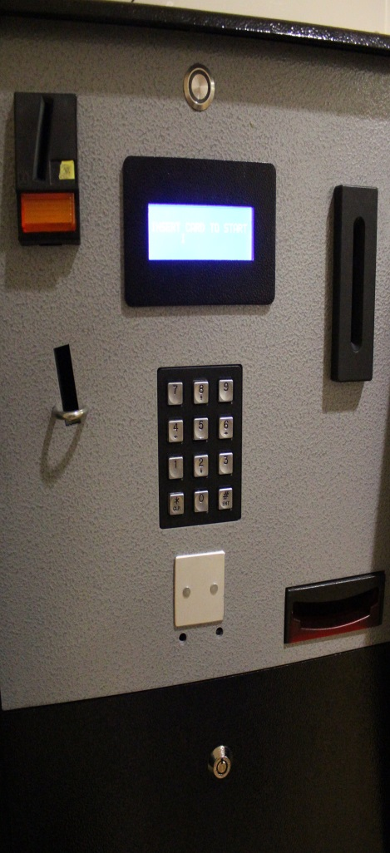
Cash-less system for school meals
We have a cashless system for school meals which means that money is added on to a pupil’s account ( either at home by a parent/carer or in school by the pupil, using the machine pictured on the left) and then pupils pay for their food at school using a 6 digit number (PIN) or your Young Scot card.
Before pupils start school in August parents/carers will get a letter from OIC explaining the system.
We will show pupils how to do this
The PIN will be given out to pupils in August on pupils’ first day of school –please encourage your child not to tell anyone their number.
Menus for school lunches are displayed around the school. They are also on the school website.
If your child has any allergies or dietary requirements, please speak to a member of the Guidance team before school starts.
Lunchtime and getting food may seem very daunting to begin with, but staff are there to help – pupils just need to ask.

Slide 17
Attendance
Illness: A parent/carer should phone the school (87 2102) before 9.00am every morning a pupil is absent. A text message is sent out if a pupil is absent and there has been no phone call.
Signing In Late: If pupils arrive late at any point in the day, they must sign in at the Reception with the office staff and give a reason for their lateness. It would be helpful if pupils could provide a note from a parent/carer or appointment card if they had a medical appointment.
Signing Out: Pupils must sign out at the office if they have to attend a doctor or dentist appointment during the school day. They must bring an appointment card/note from a parent/carer. On return to school they must sign back in at the office/reception.
Sick Bay: If pupils feel ill during the school day they should ask permission from their teacher to go to Sick Bay. If it is necessary to send a pupil home, parents /carers will be contacted. Pupils must not just go home or contact their parent/carer themselves. The office staff are happy to make the phone call..
Absences – not illness: Parents/carers should inform the school office and your child’s Guidance teacher if pupils are going to be absent during term time. If pupils are going on a trip/activity, parents/carers should write to the Head Teacher asking for permission; the absence will be recorded appropriately. If in doubt, parents /carers should speak to the Guidance Teacher.

Slide 18
Tracking, Monitoring, Reporting and Profiling at KGS
This is an on-going process of dialogue and reflection about learning from S1-S6
We need to make sure pupils understand what they are learning
It is important that pupils identify the skills being developed as part of the learning
It is important that pupils understand the relevance of learning across the curriculum and beyond the classroom

Slide 19
Tracking, Monitoring and Reporting at KGS:
We monitor individual attainment and progress throughout the year
There is regular dialogue between teachers and learners
Information is periodically recorded electronically
We identify pupils who may need additional support to achieve their potential
We share Tracking Reports with parents/carers

Slide 20
Tracking, Monitoring and Reporting at KGS
In school support:
Class Teachers
Principal Teachers
Guidance Staff
Year Heads (Senior Leadership Team)

Slide 21
Tracking, Monitoring and Reporting S1 Dates 2020/21
Parents Evening | September 2020
Tracking Report 1 | November 2020
Tracking Report 2 | March 2021

Slide 22
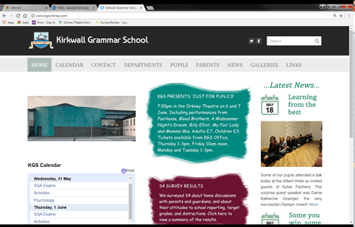
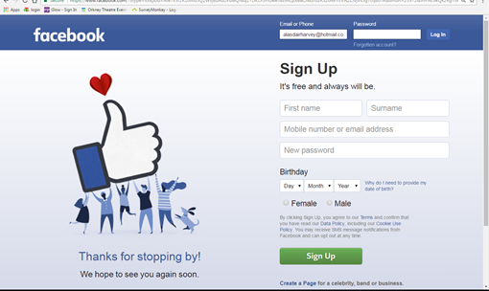
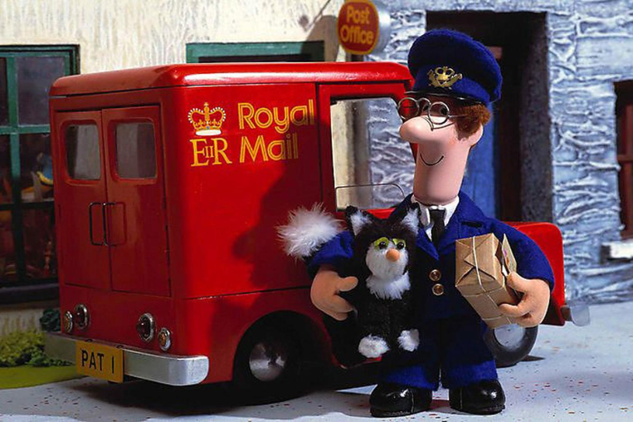
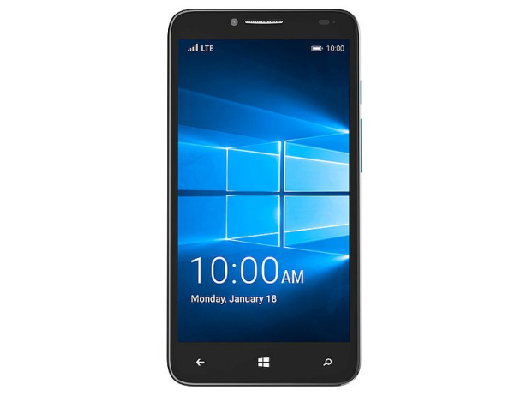
Communication

Slide 23
Mobile phone use
School policy is that mobile phones are permitted in school
However, they can only be used during class time at the class teacher’s discretion
Otherwise they should be turned off or on to silent mode and kept in school bags
If a pupil uses a mobile phone during class when they do not have permission to, the phone may be confiscated and kept safely in the school office until the end of the day

Slide 24
Skills Development Scotland
Careers Advisers
Kay Hume - linked with Copinsay House
Karen Foubister – linked with Fara House
Kerri Liddle - linked with Eynhallow House

Slide 25
KGS Careers Service
S1 – S2
Career Group Sessions
S3
1-1 on Subject Choice
Career Group Sessions
S4-S6
Career Group Sessions
1-1 Career Appointments
Parents Evenings
Parents Evenings
Parents Evenings
Drop-In
Drop-In
Drop-In

Slide 26
COVID 19 – The KGS Pledge
We know we are going through a period of change: we will try to make this as smooth as possible for your children
We know how important Primary 7 – S1 Transition is: we will try and ensure that the experience is meaningful and clear for your children
We know that you are keen to know what is going to happen: we will share any information with you, as soon as we can
Your children matter: we will do all we can to make it work for them!

