Slide 1
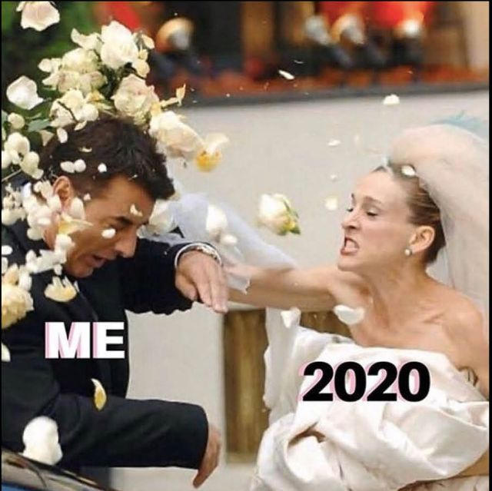
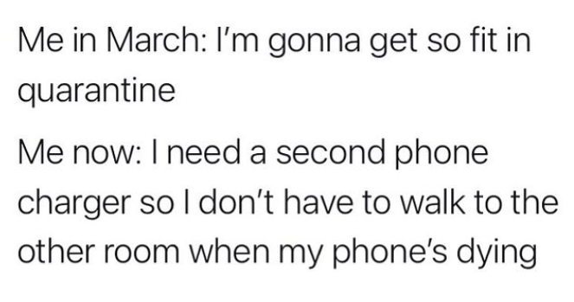
COVID homeWORK
‘quarantineavesary 2021’

Slide 2
Independent Home Work - Priorities
Updated for January 2021
S1 | S2 | S3 | N4 | N5 | H | AH
FOCUS ON CORE SUBJECTS | FOCUS ON CORE SUBJECTS | Website Design (see teams) | PONG GAME (see teams) | Revision priorities (red sheet, see teams) | Revision priorities (red sheet, see teams) | Professional project WEEKLY THEORY TASKS Revision FOR PRELIM
 |  |  | Python challenges | Programming Python / HTML / CSS / SQL | Programming Python / HTML / CSS / SQL
 | Idea
 |  | Idea | idea | Past papers | Past papers
Any questions? Email Mr Soames: denis.soames@glow.orkneyschools.org.uk

Slide 3
FAQs

Slide 4
FAQs
Any questions? Email Mr Soames: denis.soames@glow.orkneyschools.org.uk
N5 Student - # Mr Soames – #. | Higher Student - # Mr Soames – # | All students - # Mr Soames – #

Slide 5
BGE

Slide 6
BGE – Computing Science
Focus on your core subjects set work first.
If you have time, remember to log into IDEA.org.uk with your credentials including your school email address (check your Glow), and if necessary reset your password using the ‘Forgot Password’ tool.
Any questions? Email Mr Soames: denis.soames@glow.orkneyschools.org.uk

Slide 7
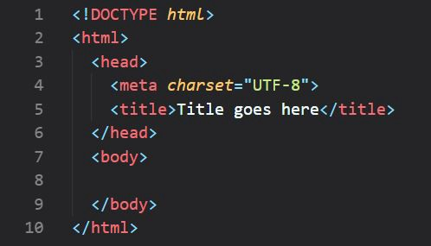
S3 – Computing Science
Plan around 1-2 hours per week for Computing Science.
Ideally you will use a computer to log in as coding is much easier with a proper keyboard, but work should also be possible on tablets, phones, netbooks, consoles etc. Remember you can plug in a keyboard into your console or tablet to help. Ask parents for support and feel free to contact me with issues.
Log into your Teams via Glow
Follow instructions on completing weekly tasks found in Assignments and your Class Notebook.
Any questions? Email Mr Soames: denis.soames@glow.orkneyschools.org.uk

Slide 8
SENIOR
PHASE

Slide 9
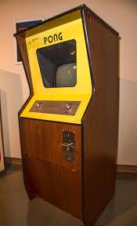
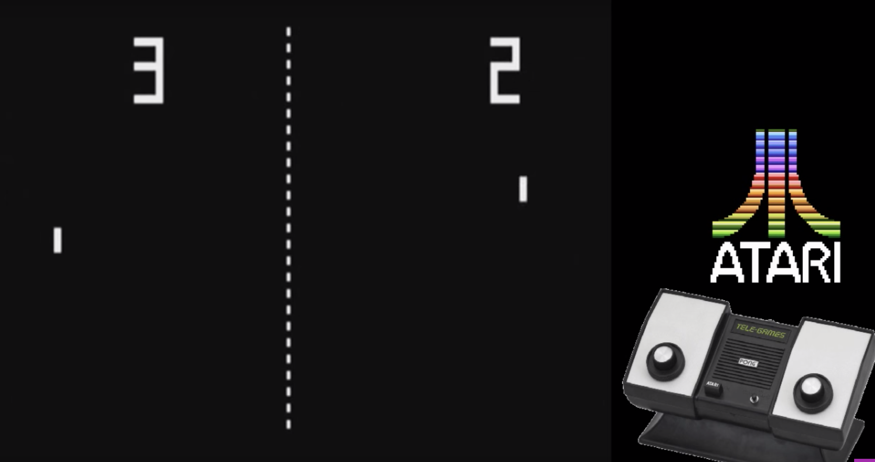
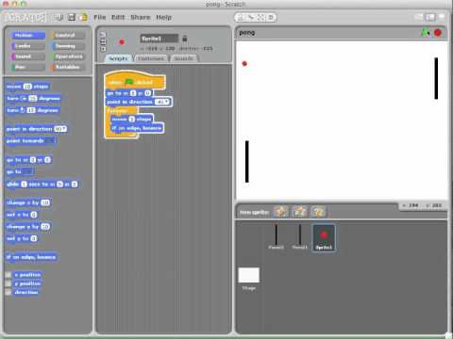
N4 – Computing Science
Plan around 2-3 hours per week (minimum!) for Computing Science.
Ideally you will use a computer to log in as coding is much easier with a proper keyboard, but work should also be possible on tablets, phones, netbooks, consoles etc. Remember you can plug in a keyboard into your console or tablet to help. Ask parents for support and feel free to contact me with issues.
Log into your Teams via Glow
Follow instructions on completing weekly tasks found in Assignments and your Class Notebook.
Any questions? Email Mr Soames: denis.soames@glow.orkneyschools.org.uk

Slide 10
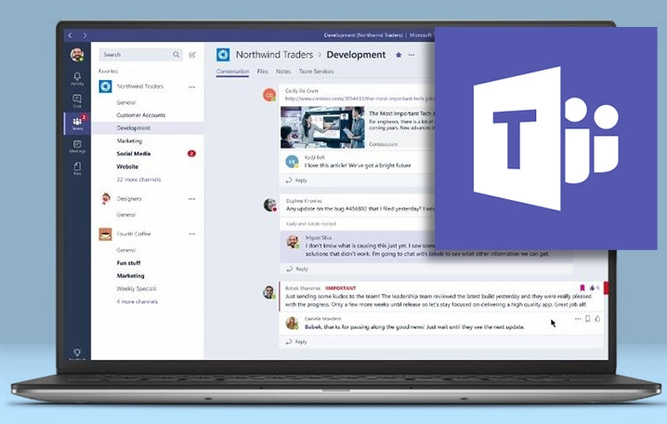
Higher – Computing Science
Task 1 Pseudocode (Around 25% of marks from paper 2 come from pseudocode related questions) Have a look through the following slides which highlight potential pitfalls in Exam Paper 2, centring around Algorithms (especially pseudocode) Try the ESQ on slide 14 and then the challenges of the link below OCR Pseudocode Challenges | Task 2 Need a P.E.E.? So many of you struggle with properly answering PEE questions. If the question uses the phrase DESCRIBE or EXPLAIN or other high functioning verb such as COMPARE, ANALYSE, DISCUSS or ‘with reference to the code. Using SQA past papers choose 5 questions worth 2 or 3 marks to attempt. Use P.E.E to answer and aim to score all of the marks. When complete, use the mark scheme to see how you did | Bitesize: Revision Computational thinking, algorithms and programming: Edpuzzle resources Past Papers Coggle.it SQL Zoo CodeAcademy CodeCombat National5computing.co.uk/sql
Microsoft Teams Challenges Visit Microsoft Teams regularly for revision tasks to be completed and handed in..
Resources
Any questions? Email Mr Soames: denis.soames@glow.orkneyschools.org.uk

Slide 11
Advanced Higher – Computing Science
Your main focus (3hrs/wk of your time) is completing your project.
Revisit the milestones we have already agreed prior to Xmas, complete them all and move on to the next sections.
Work on Development of your project, get your code working and touch base with me with any problems.
Weekly updates with me as to your progress on your project, phone (schedule a time with me), email, teams.
Each week I will include a theory element to complete (2hrs/wk of your time), the weekly challenges are set on MS Teams and handed in via Class Notebook.
Week 1 Research and report on Bubble Sort and Insertion Sort
Week 2 Code either a Bubble Sort or Insertion Sort using a standard algorithm
Week 3 Writing multiple lines of SQL data to a table in PHP
Week 4 SQL CREATE and DROP revision, introduce HAVING.
Project Soft deadline – 5th of April Hard deadline – TBC
Any questions? Email Mr Soames: denis.soames@glow.orkneyschools.org.uk

Slide 12
SOAMES’ CHALLENGE

Slide 13
N4, N5, Higher, Adv Higher - Building a Simulator
Simulators/models give understanding of a virus to make predictions.
Read: https://www.poynter.org/reporting-editing/2020/how-a-blockbuster-washington-post-story-made-social-distancing-easy-to-understand/
Using your choice of either Scratch (S3/N4), Small Basic(S3/N4), or Python PyGame (N4, N5, Higher, Adv Higher).
Get a ball bouncing around the screen
Randomly generate one ball a RED colour and many others BLACK.
If RED ball touches BLACK then it should turn BLACK to RED
After a period of time RED should turn GREEN and no longer infect others.
Any questions? Email Mr Soames: denis.soames@glow.orkneyschools.org.uk

